Slide 1
Data Science Capstone Project

Slide 2
Outline
• Executive Summary
• Introduction
• Methodology
• Results
• Conclusion
• Appendix

Slide 3
Executive Summary
Summary of methodologies
- Data collection
- Data wrangling
- Exploratory Data Analysis with Data Visualization
- Exploratory Data Analysis with SQL
- Building an interactive map with Folium
- Predictive analysis (Classification)
Summary of all results
- Exploratory Data Analysis results
- Interactive analytics demo in screenshots
- Predictive analysis results

Slide 4
Introduction
Project background and context
SpaceX is the most successful company of the commercial space age, making space travel affordable. The company advertises Falcon 9 rocket launches on its website, with a cost of 62 million dollars; other providers cost upward of 165 million dollars each, much of the savings is because SpaceX can reuse the first stage. Therefore, if we can determine if the first stage will land, we can determine the cost of a launch. Based on public information and machine learning models, we are going to predict if SpaceX will reuse the first stage.
Questions to be answered
- How do variables such as payload mass, launch site, number of flights, and orbits affect the success of the first stage landing?
- Does the rate of successful landings increase over the years?
- What is the best algorithm that can be used for binary classification in this case?

Slide 5
Data collection
Data collection process involved a combination of API requests from SpaceX REST
API and Web Scraping data from a table in SpaceX’s Wikipedia entry.
We had to use both of these data collection methods in order to get complete
information about the launches for a more detailed analysis.
Data Columns are obtained by using SpaceX REST API:
FlightNumber, Date, BoosterVersion, PayloadMass, Orbit, LaunchSite, Outcome, Flights, GridFins, Reused, Legs, LandingPad, Block, ReusedCount, Serial, Longitude, Latitude
Data Columns are obtained by using Wikipedia Web Scraping:
Flight No., Launch site, Payload, PayloadMass, Orbit, Customer, Launch outcome, Version Booster, Booster landing, Date, Time

Slide 6
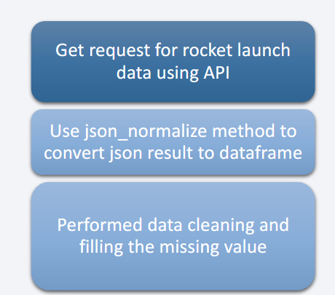
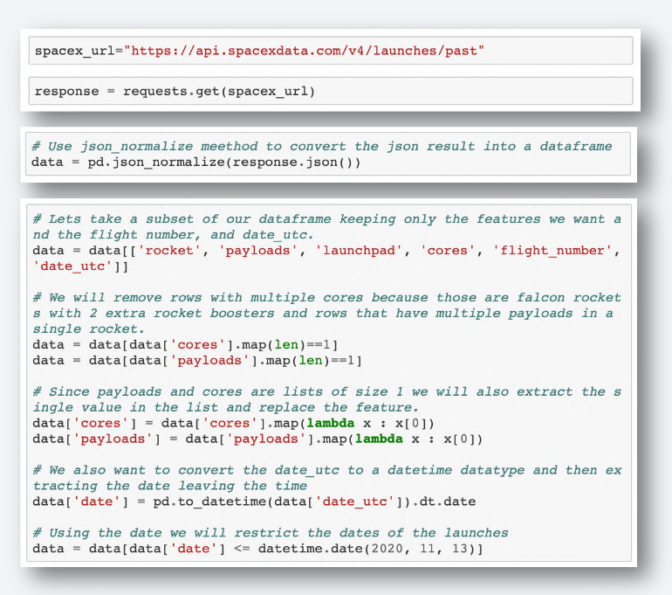
Data Collection – SpaceX API
https://github.com/zezinh0/Applied-Data-Science-Capstone/blob/main/jupyter-labs-spacex-data-collection-api.ipynb

Slide 7
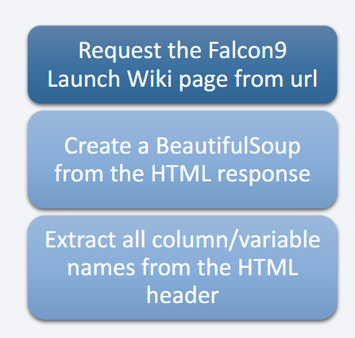
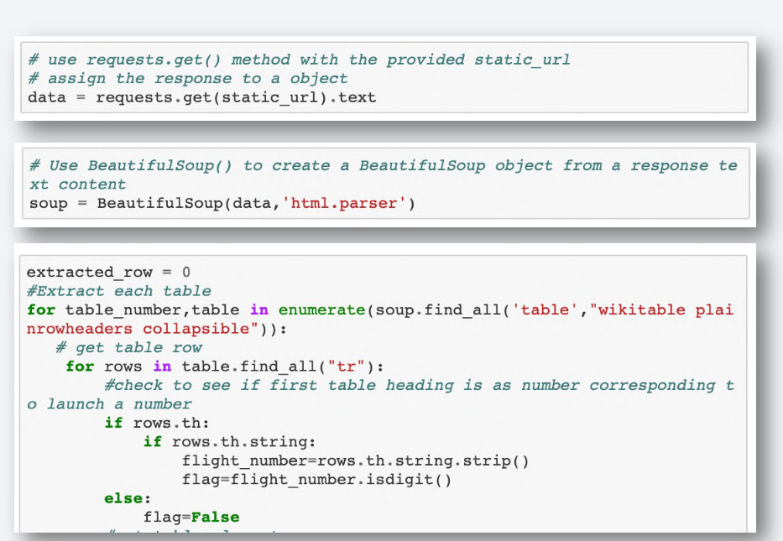
Data Collection - Scraping
https://github.com/zezinh0/Applied-Data-Science-Capstone/blob/main/jupyter-labs-spacex-data-collection-api.ipynb

Slide 8
Data Wrangling
Data Wrangling is the process of cleaning and unifying messy and complex data sets for easy access and Exploratory Data Analysis (EDA).
We will first calculate the number of launches on each site, then calculate the number and occurrence of mission outcome per orbit type.
We then create a landing outcome label from the outcome column. This will make it easier for further analysis, visualization, and ML. Lastly, we will export
the result to a CSV.
https://github.com/zezinh0/Applied-Data-Science-Capstone/blob/main/labs-jupyter-spacex-Data%20wrangling.ipynb

Slide 9
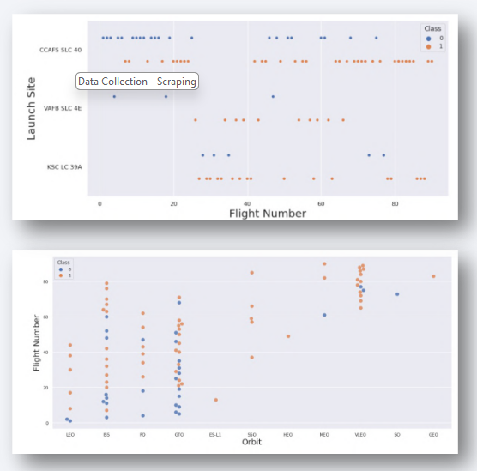
EDA with Data Visualization
We first started by using scatter graph to find the relationship between the attributes such as between:
• Payload and Flight Number.
• Flight Number and Launch Site.
• Payload and Launch Site.
• Flight Number and Orbit Type.
• Payload and Orbit Type.
Scatter plots show dependency of attributes on each other. Once a pattern is determined from the graphs. It’s very easy to see which factors affecting the most to the success of the landing outcomes.

Slide 10
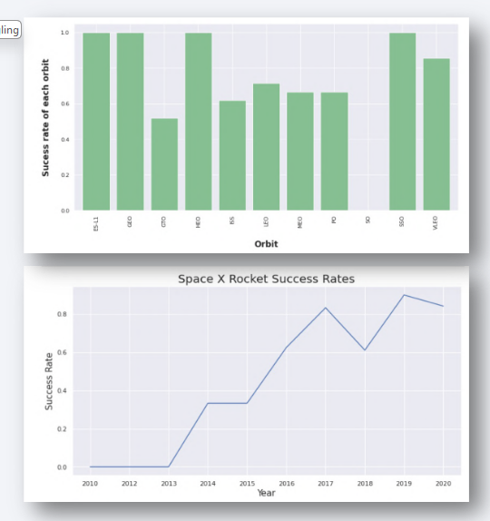
EDA with Data Visualization
Once we get a hint of the relationships using scatter plot. We will then use further visualization tools such as bar graph and line plots graph for further analysis.
Bar graphs is one of the easiest way to interpret the relationship between the attributes. In this case, we will use the bar graph to determine which orbits have the highest probability of success.
We then use the line graph to show a trends or pattern of the attribute over time which in this case, is used for see the launch success yearly trend.
We then use Feature Engineering to be used in success prediction in the future module by created the dummy variables to categorical columns.

Slide 11
EDA with SQL
Using SQL, we had performed many queries to get better understanding of the dataset, Ex:
- Displaying the names of the launch sites.
- Displaying 5 records where launch sites begin with the string ‘CCA’.
- Displaying the total payload mass carried by booster launched by NASA (CRS).
- Displaying the average payload mass carried by booster version F9 v1.1.
- Listing the date when the first successful landing outcome in ground pad was achieved.
- Listing the names of the boosters which have success in drone ship and have payload mass
greater than 4000 but less than 6000.
- Listing the total number of successful and failure mission outcomes.
- Listing the names of the booster_versions which have carried the maximum payload mass.
- Listing the failed landing_outcomes in drone ship, their booster versions, and launch sites
names for in year 2015.
- Rank the count of landing outcomes or success between the date 2010-06-04 and
2017-03-20, in descending order.
https://github.com/zezinh0/Applied-Data-Science-Capstone/blob/main/jupyter-labs-eda-sql-coursera_sqllite.ipynb

Slide 12
Build an Interactive Map with Folium
To visualize the launch data into an interactive map. We took the latitude and longitude
coordinates at each launch site and added a circle marker around each launch site with a
label of the name of the launch site.
We then assigned the dataframe launch_outcomes(failure,success) to classes 0 and 1 with
Red and Green markers on the map in MarkerCluster().
We then used the Haversine’s formula to calculated the distance of the launch sites to
various landmark to find answer to the questions of:
• How close the launch sites with railways, highways and coastlines?
• How close the launch sites with nearby cities?
https://github.com/zezinh0/Applied-Data-Science-Capstone/blob/main/lab_jupyter_launch_site_location.ipynb

Slide 13
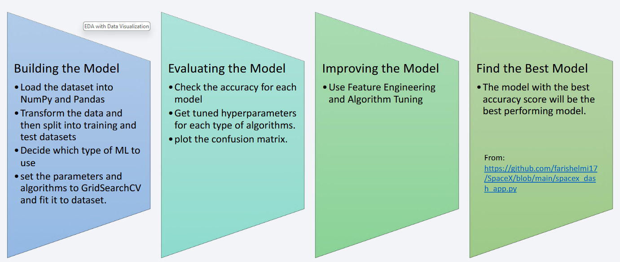
Predictive Analysis (Classification)
https://github.com/zezinh0/Applied-Data-Science-Capstone/blob/main/SpaceX_Machine%20Learning%20Prediction_Part_5.ipynb

Slide 14
Results
The results will be categorized to 3 main results which is:
• Exploratory data analysis results
• Interactive analytics demo in screenshots
• Predictive analysis results

Slide 15
INSIGHTS DRAW FROM EDA

Slide 16
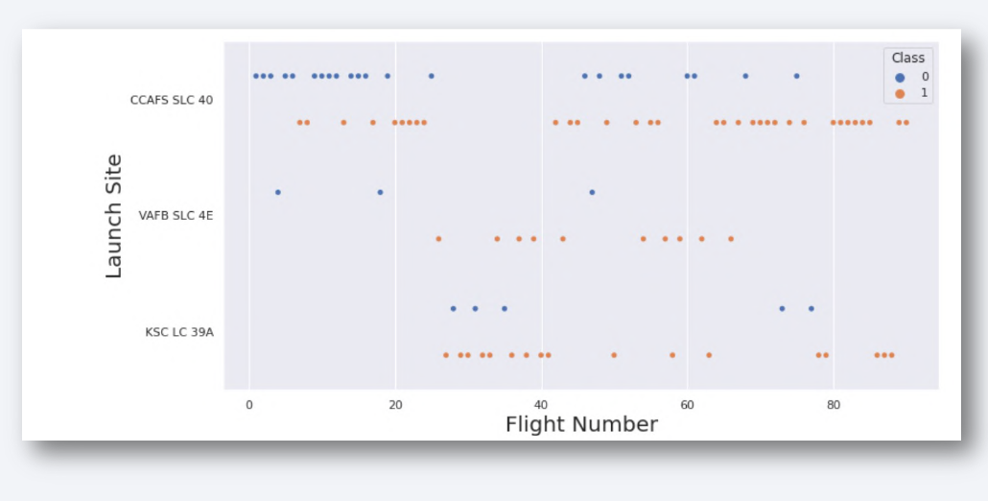
Flight Number vs. Launch Site
This scatter plot shows that the larger the flights amount of the launch site, the greater the the success rate will be.
However, site CCAFS SLC40 shows the least pattern of this.

Slide 17
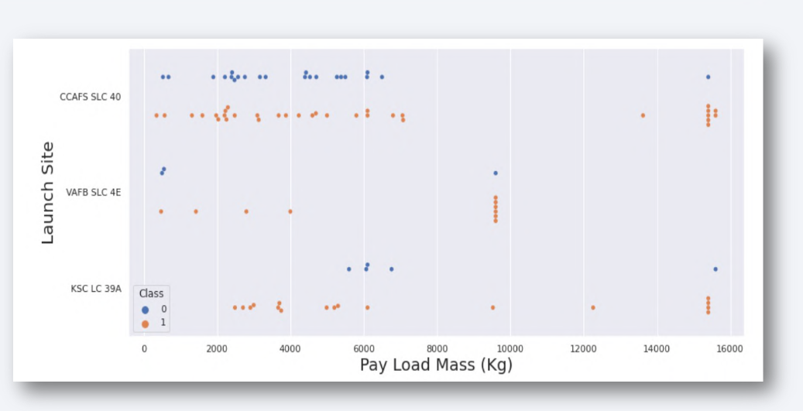
Payload vs. Launch Site
This scatter plot shows once the pay load mass is greater than 7000kg, the
probability of the success rate will be highly
increased.
However, there is no clear pattern to say the launch site is dependent to the pay
load mass for the success rate.

Slide 18
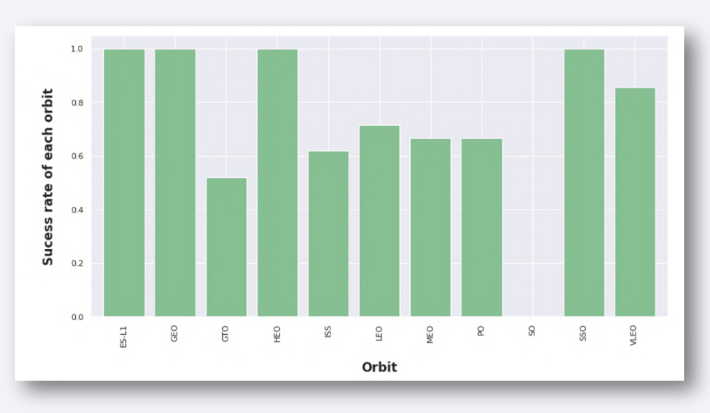
Success Rate vs. Orbit Type
This figure depicted the
possibility of the orbits to
influences the landing outcomes
as some orbits has 100% success
rate such as SSO, HEO, GEO AND
ES-L1 while SO orbit produced
0% rate of success.
However, deeper analysis show
that some of this orbits has only
1 occurrence such as GEO, SO,
HEO and ES-L1 which mean this
data need more dataset to see
pattern or trend before we draw
any conclusion.

Slide 19
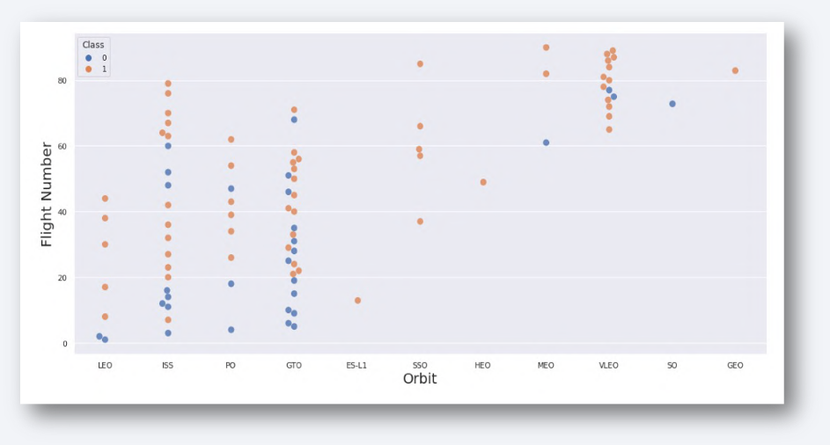
Flight Number vs. Orbit Type
This scatter plot shows that
generally, the larger the flight
number on each orbits, the
greater the success rate
(especially LEO orbit) except for
GTO orbit which depicts no
relationship between both
attributes.
Orbit that only has 1 occurrence
should also be excluded from
above statement as it’s needed
more dataset.

Slide 20
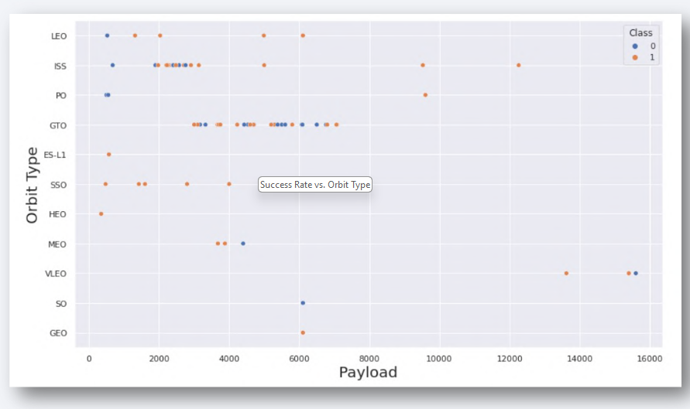
Payload vs. Orbit Type
Heavier payload has positive
impact on LEO, ISS and P0 orbit.
However, it has negative impact
on MEO and VLEO orbit.
GTO orbit seem to depict no
relation between the attributes.
Meanwhile, again, SO, GEO and
HEO orbit need more dataset to
see any pattern or trend.

Slide 21
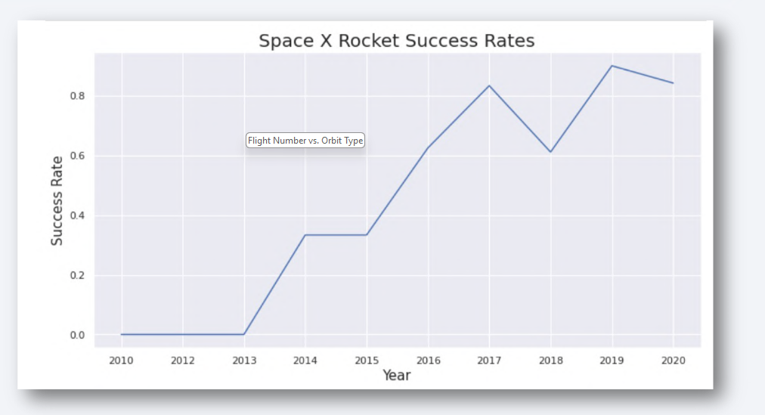
Launch Success Yearly Trend
This figures clearly depicted
and increasing trend from
the year 2013 until 2020.
If this trend continue for the
next year onward. The
success rate will steadily
increase until reaching
1/100% success rate.

Slide 22
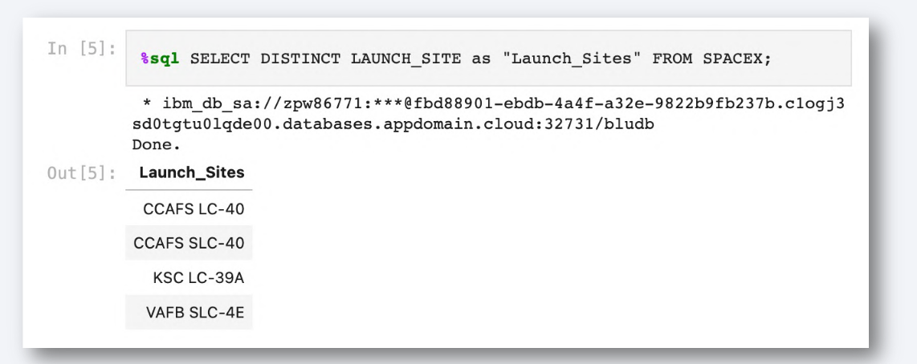
All Launch Site Names
We used the key word DISTINCT to show only unique launch sites
from the SpaceX data.

Slide 23
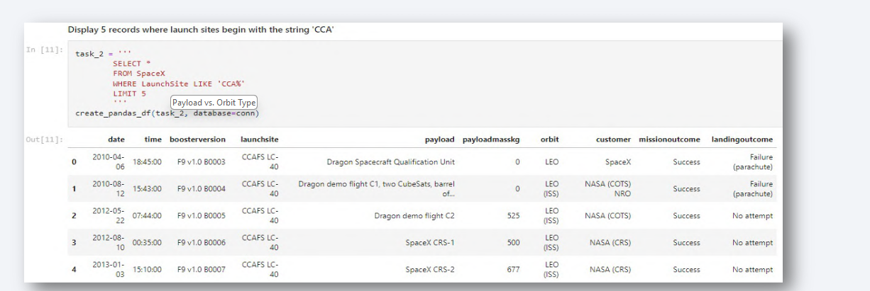
Launch Site Names Begin with 'CCA'
We used the query above to display 5 records where launch sites
begin with `CCA`

Slide 24
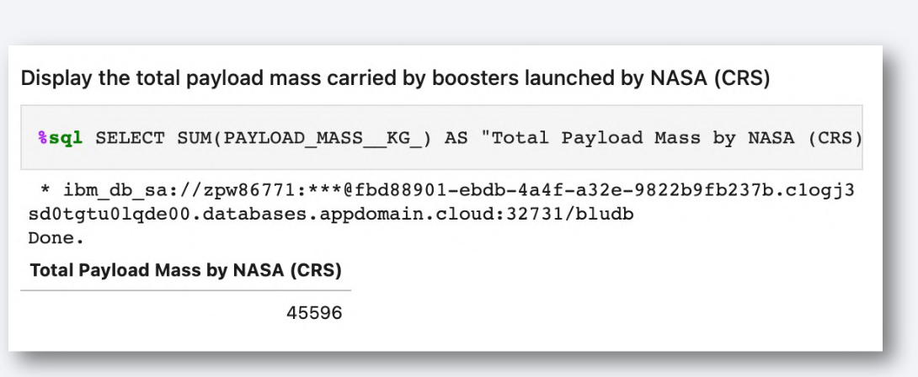
Total Payload Mass
We calculated the total payload carried by boosters from NASA
as 45596 using the query below

Slide 25
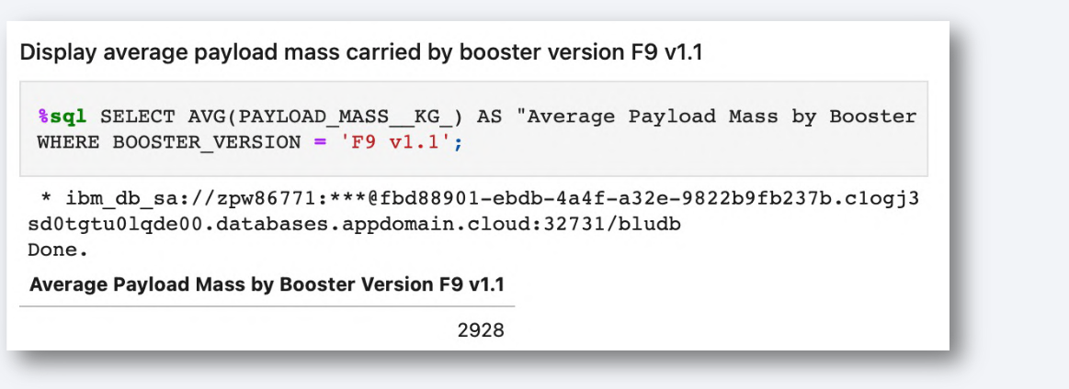
Average Payload Mass by F9 v1.1
We calculated the average payload mass carried by booster version
F9 v1.1 as 2928.4

Slide 26
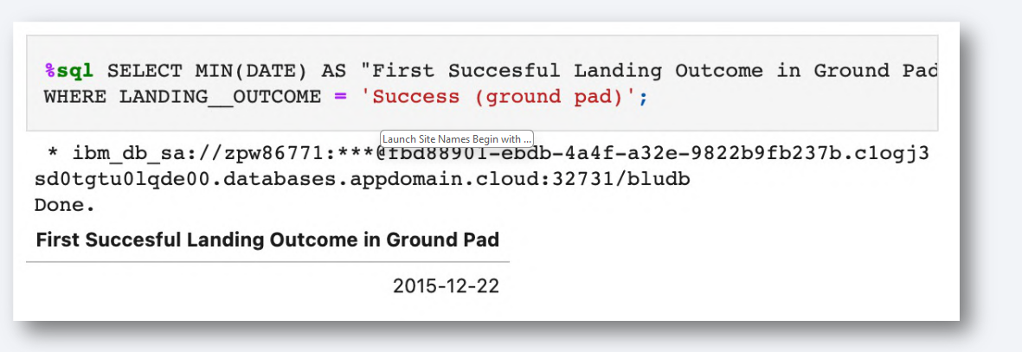
First Successful Ground Landing Date
We use the min() function to find the result
We observed that the dates of the first successful landing outcome on ground
pad was 22nd December 2015

Slide 27
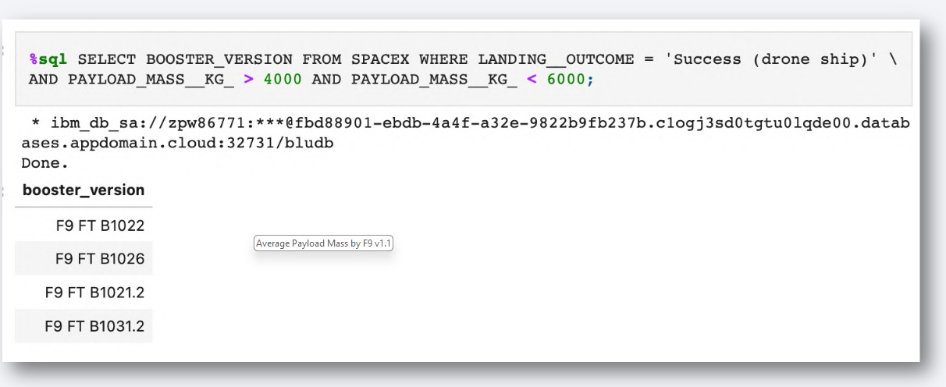
Successful Drone Ship Landing with Payload between 4000 and 6000
We used the WHERE clause to filter for boosters which have successfully landed on drone ship and applied the AND condition to determine successful landing with payload mass greater than 4000 but less than 6000

Slide 28
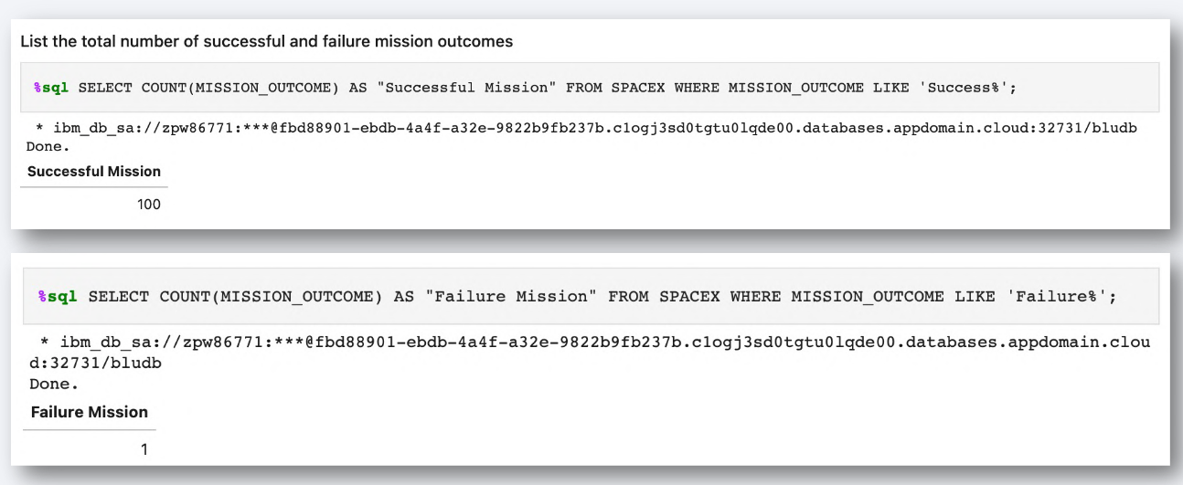
Total Number of Successful and Failure Mission Outcomes
We used wildcard like ‘%’ to filter for WHERE MissionOutcome was a success or a failure.

Slide 29
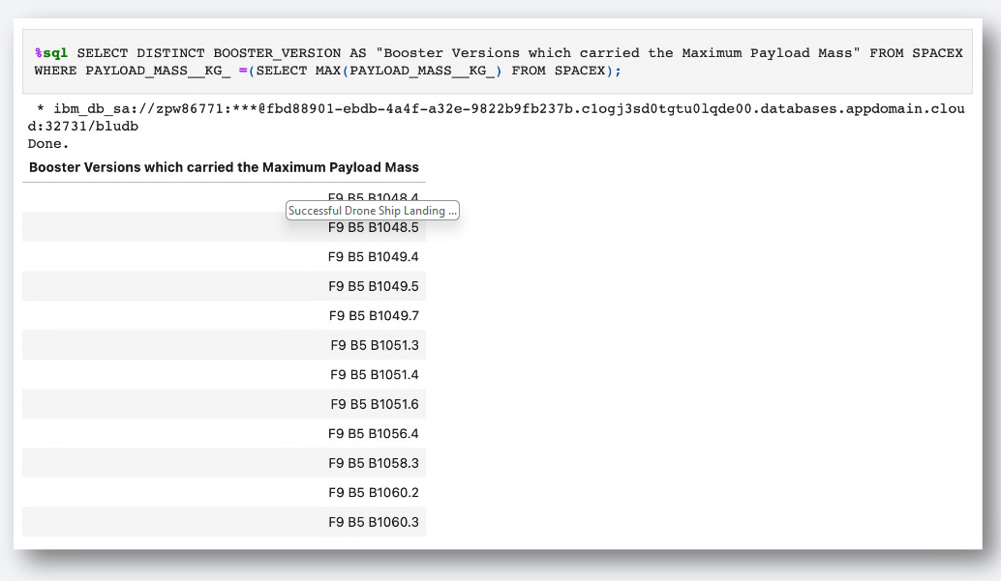
Boosters Carried Maximum Payload
We determined the
booster that have
carried the maximum
payload using a
subquery in the
WHERE clause and
the MAX() function

Slide 30
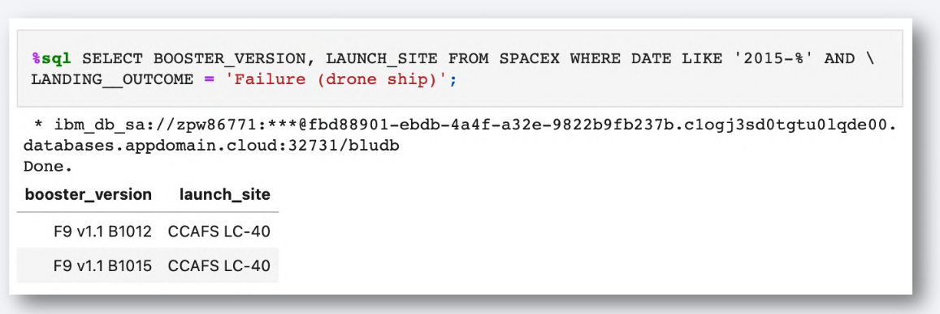
2015 Launch Records
We used a combinations of the WHERE clause, LIKE, AND, and BETWEEN
conditions to filter for failed landing outcomes in drone ship, their booster
versions, and launch site names for year 2015

Slide 31
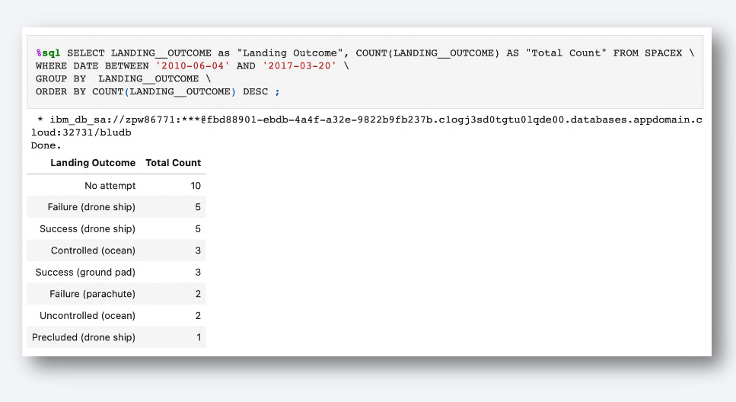
Rank Landing Outcomes Between 2010-06-04 and 2017-03-20
We selected Landing outcomes
and the COUNT of landing
outcomes from the data and
used the WHERE clause to
filter for landing outcomes
BETWEEN 2010-06-04 to
2010-03-20.
We applied the GROUP BY
clause to group the landing
outcomes and the ORDER BY
clause to order the grouped
landing outcome in
descending order.

Slide 32
LAUNCH SITES PROXIMITIES ANALYSIS

Slide 33
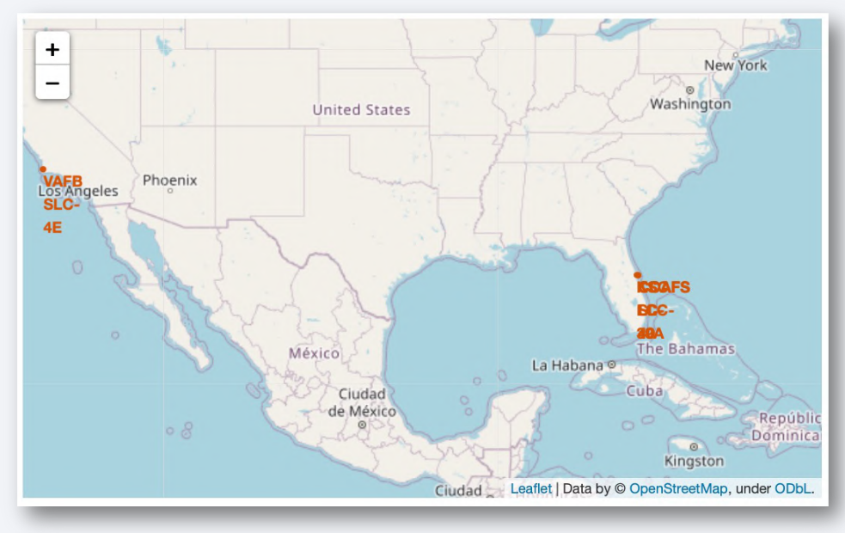
Location of all the Launch Sites
We can see that
all the SpaceX
launch sites are
located inside
the United
States

Slide 34
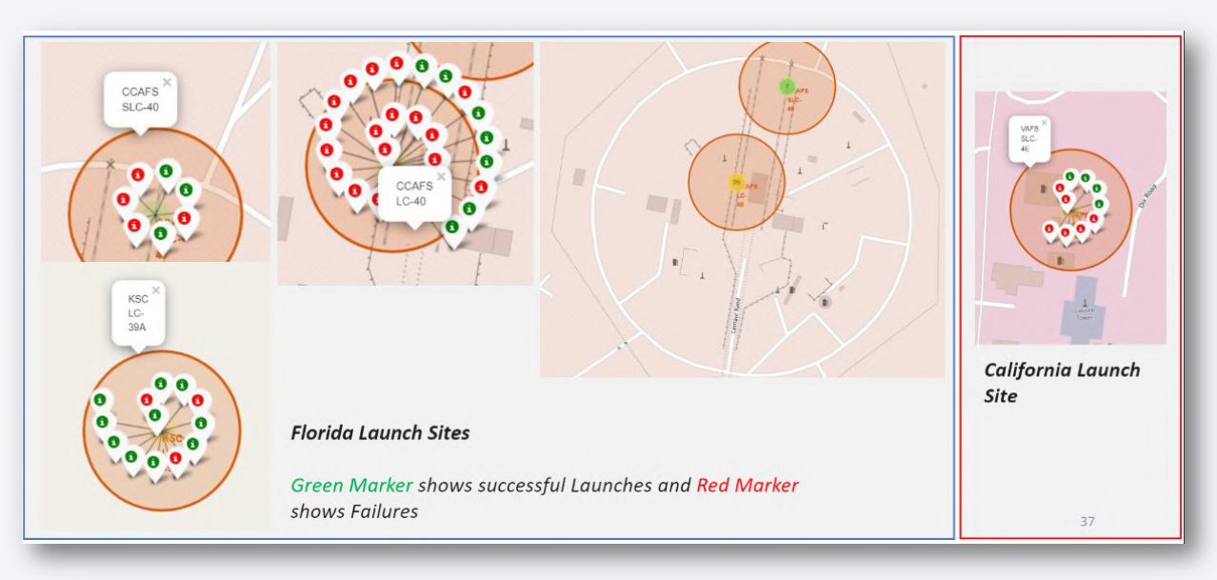
Markers showing launch sites with color labels

Slide 35
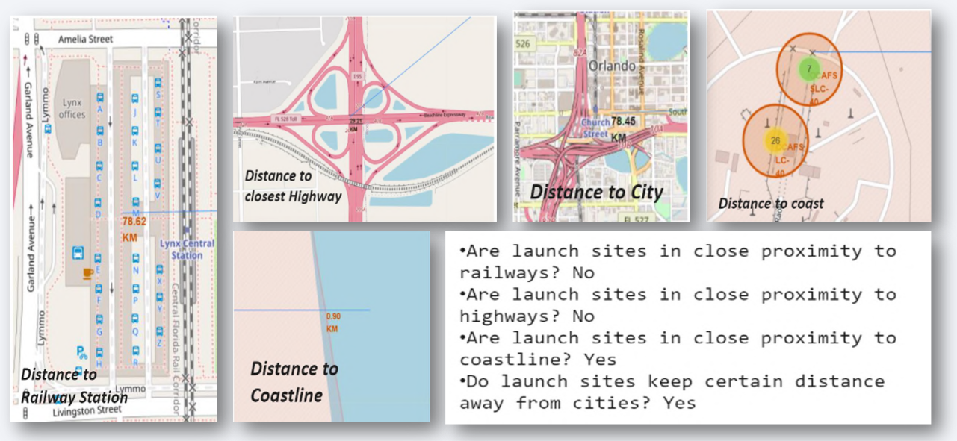
Launch Sites Distance to Landmarks

Slide 36
PREDICTIVE ANALYSIS (CLASSIFICATIONN)

Slide 37
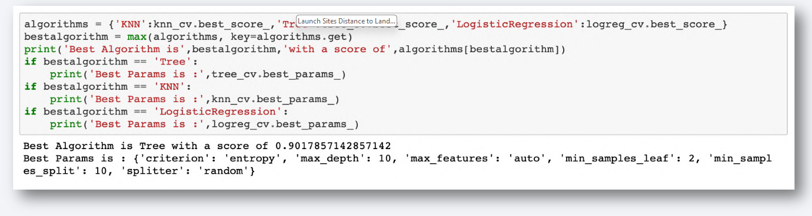
Classification Accuracy
As we can see, by using the code as below: we could identify that the best algorithm to be the Tree Algorithm which have the highest classification accuracy.

Slide 38
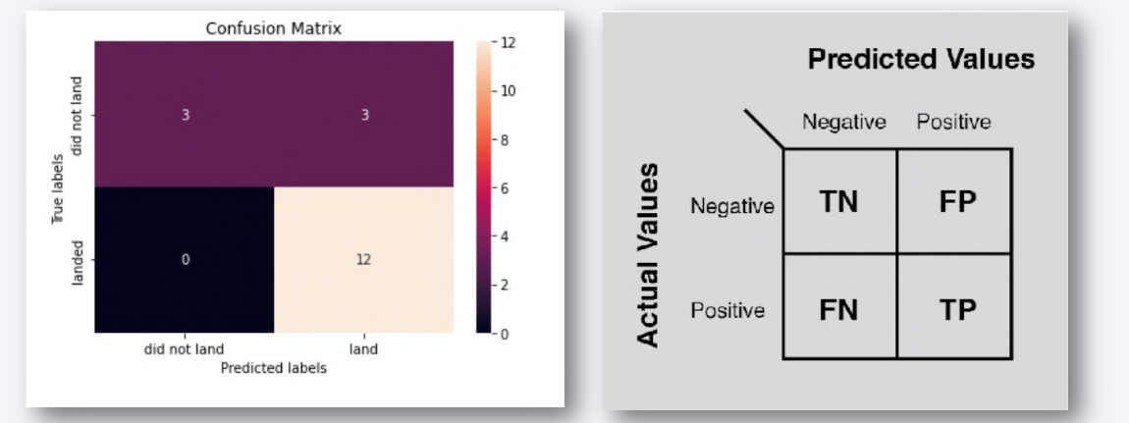
Confusion Matrix
The confusion matrix for the decision tree classifier shows that the classifier can
distinguish between the different classes. The major problem is the false positives i.e., unsuccessful landing marked as successful landing by the classifier.

Slide 39
Conclusion
We can conclude that:
• The Tree Classifier Algorithm is the best Machine Learning approach for this dataset.
• The low weighted payloads (which define as 4000kg and below) performed better than the heavy weighted payloads.
• Starting from the year 2013, the success rate for SpaceX launches is increased, directly proportional time in years to 2020, which it will eventually perfect the launches in the future.
• KSC LC-39A have the most successful launches of any sites; 76.9%
• SSO orbit have the most success rate; 100% and more than 1 occurrence.

